Slide 1
$sort and $limit

Slide 2
$sort and $limit
$sort returns documents in a specific order
$limit restricts the number of documents returned.
Together, they can be used to return “top 10” and similar

Slide 3
High level syntax
{$sort:{fieldReference:[1|-1]}}
{$limit:documentCount}

Slide 4
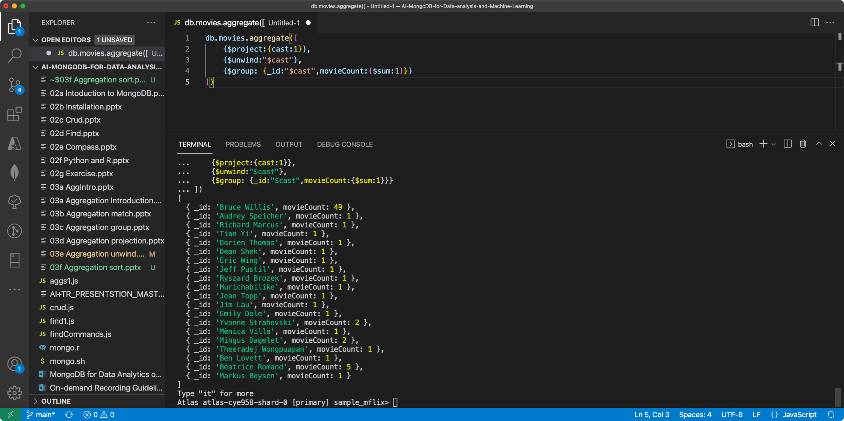

Slide 5
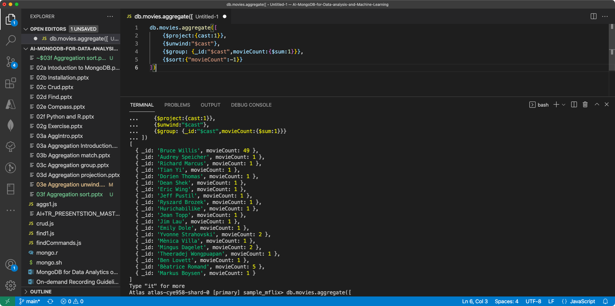

Slide 6
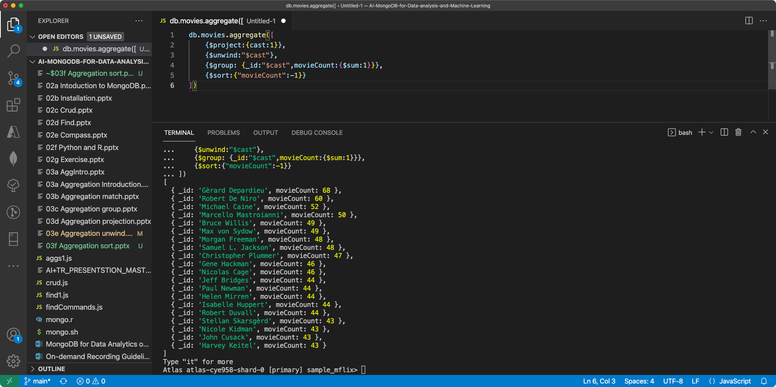

Slide 7
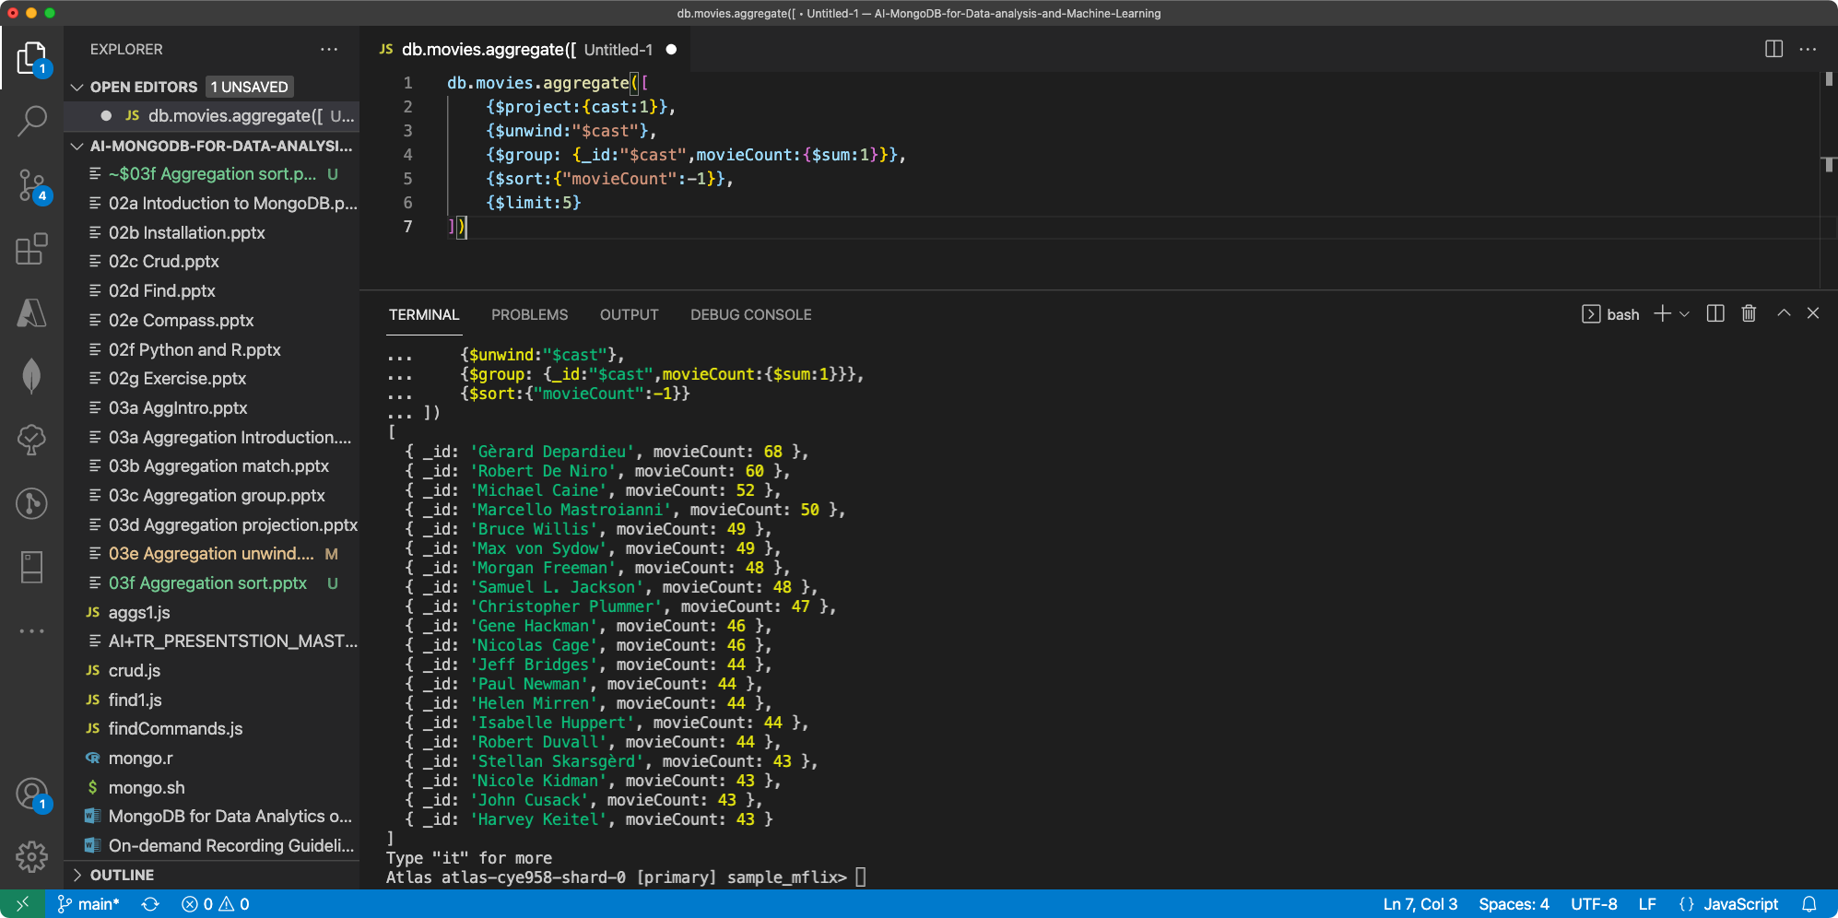

Slide 8
